Slide 1
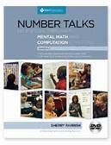
Number Talks Helping Children Build Mental Math and Computation Strategies by Sherry Parrish

Slide 2
What is a Number Talk?
a classroom conversation around purposefully crafted computation problems that are solved mentally
opportunity to collectively reason
5 – 15 minutes long
whole- or small- group

Slide 3
Rationale for Number Talks
many students think of mathematics as a set of procedures or rules
memorization of procedures crumbles when they are asked to generalize concepts
Our students MUST have the ability to…
reason about quantitative information
possess number sense
check for the reasonableness of answers

Slide 4
Students must be able to compute…
Accurately
get correct answer
Efficiently
Choose an appropriate, expedient strategy
Flexibly
Use number relationships with ease

Slide 5
Example…
49 x 5
A student should think 50 is one more group of 5, so I can up 49 to 50 and then subtract one group of 5.
50 x 5 = 250
250 – 5 = 245

Slide 6
Aligns with Common Core Standards
Standards of Mathematical Practices
Grade level content standards

Slide 7
In summary…
Number Talks is a purposeful vehicle:
making sense of mathematics
developing efficient computation strategies
communicating mathematically
reasoning and proving solutions

Slide 8
Key Components
Classroom environment and community
Classroom discussions
The teacher’s role
The role of mental math
Purposeful computation problems

Slide 9
4 Essentials to Setting Procedures and Expectations
Select a designated location
Provide appropriate wait time
Accept, respect, and consider all answers
Encourage student communication

Slide 10
Format of a Number Talk
1. Teacher presents the problem.
2. Students figure out the answer.
3. Students share their answers.
4. Students share their thinking.
5. The class agrees on the "real" answer for the problem.
6. The steps are repeated for additional problems.

Slide 11
Goals for K – 2 Number Talks
Developing number sense
Developing fluency with small numbers
Subitizing
Making tens

Slide 12
Use Models & Tools
number lines
hundred chart
real life context
unifex cubes
ten frames
dot cards
rekenreks
literature

Slide 13
Math Talk

Slide 14
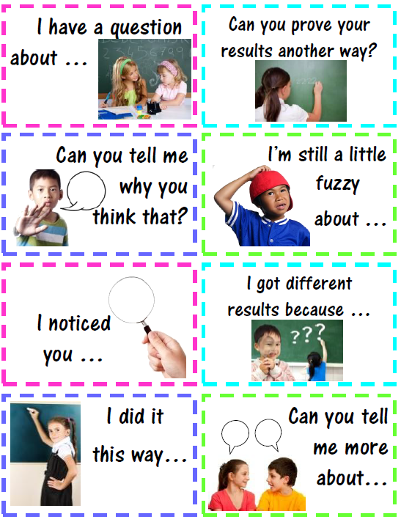
Accountable Talk

Slide 15
Reinforce concepts through practice…

Slide 16
Common Core Standards

Slide 17
VPS Kindergarten Scope & Sequence

Slide 19
VPS 1st Grade Scope & Sequence

Slide 20
Questions

